Slide 1

Convaneo
Evan Steinhoff, Conner Peterson, Leo Dai

Slide 2

Our Story

Slide 3




Language Inspirations

Slide 4

Examples

Slide 5


Slide 6


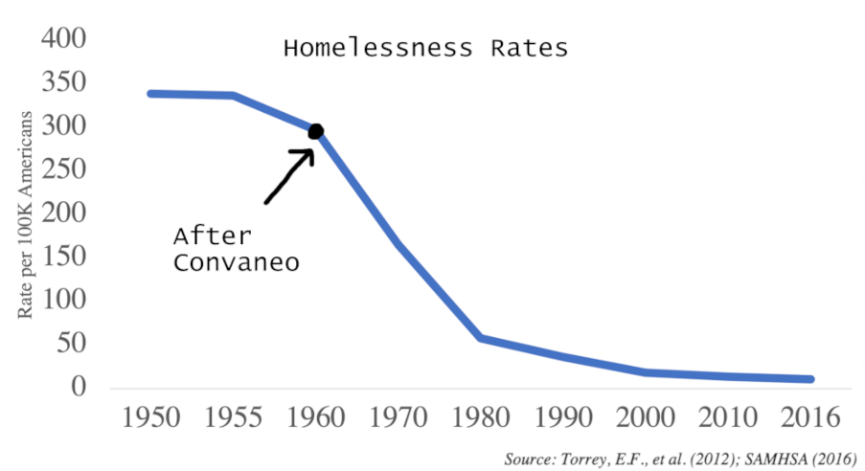
What Issues Does Convaneo Solve?

Slide 7
Our site
https://convaneo.vercel.app/

Slide 8

Thanks!
Do you have any questions?

